Slide 1

Instagram User Engagement & Marketing Insights Using SQL
Prepared by: SREEISWARYA.S.P

Slide 2
Project Description
Purpose: Analyze Instagram user interaction data using SQL to provide marketing and investor insights.
Goals:
Reward loyal users
Re-engage inactive users
Identify top hashtags
Optimize ad campaign timing
Detect bot accounts
Track user engagement trends

Slide 3
Approach
01
02
03
Database Setup
Query Development
Analysis
Imported and structured data into MySQL Workbench.
Created SQL queries for both marketing and investor metrics.
Used aggregation, joins, and CTEs to extract insights.
04
05
Validation
Reporting
Cross-checked data for accuracy.
Converted outputs into actionable business insights.

Slide 4



Tech Stack
MySQL Workbench 8.0
SQL
Windows 10
Query execution & DB management
Data extraction and analysis
Development environment

Slide 5
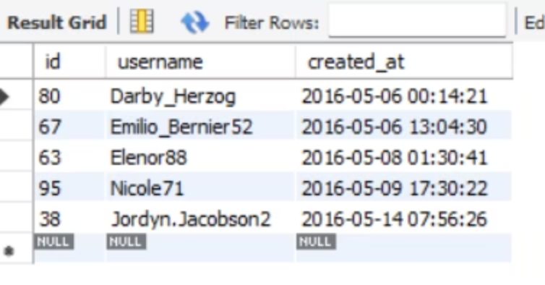
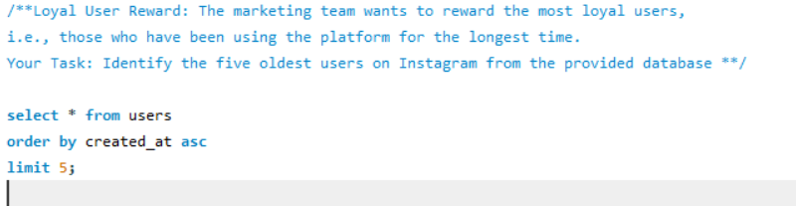
Query 1: Loyal User Reward
Goal: Find the 5 oldest users.
Output:
This query allows us to pinpoint users who have been with us since the beginning.
Rewarding these users can significantly boost retention and encourage positive word-of-mouth marketing, strengthening community ties and overall brand perception.

Slide 6
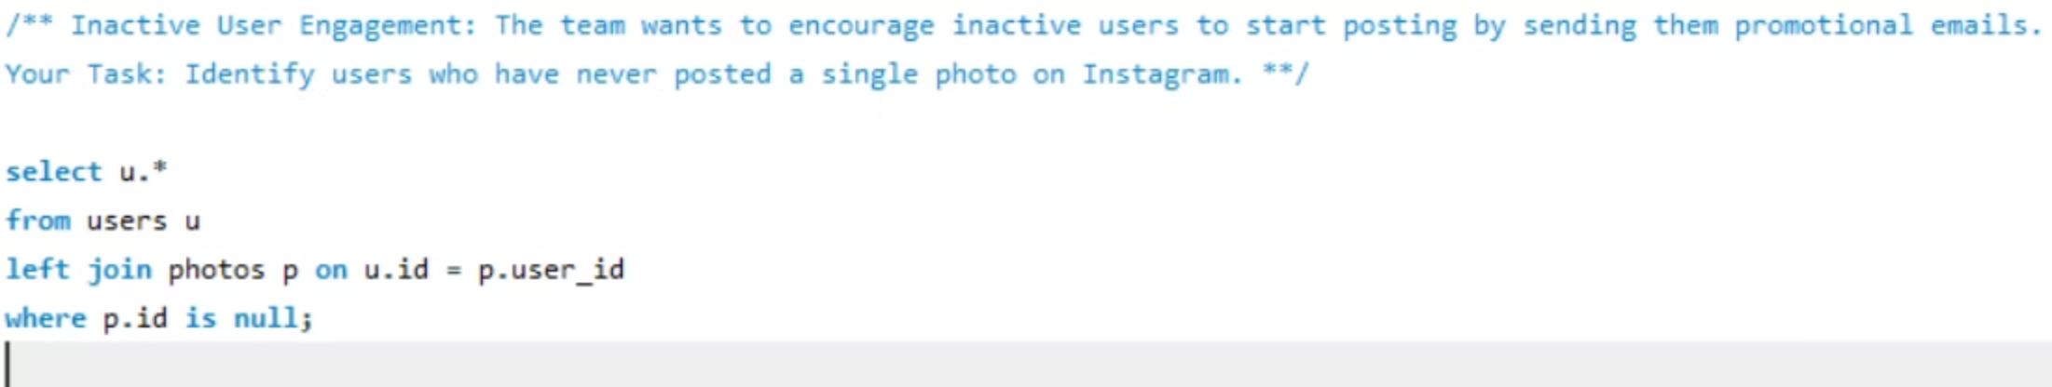
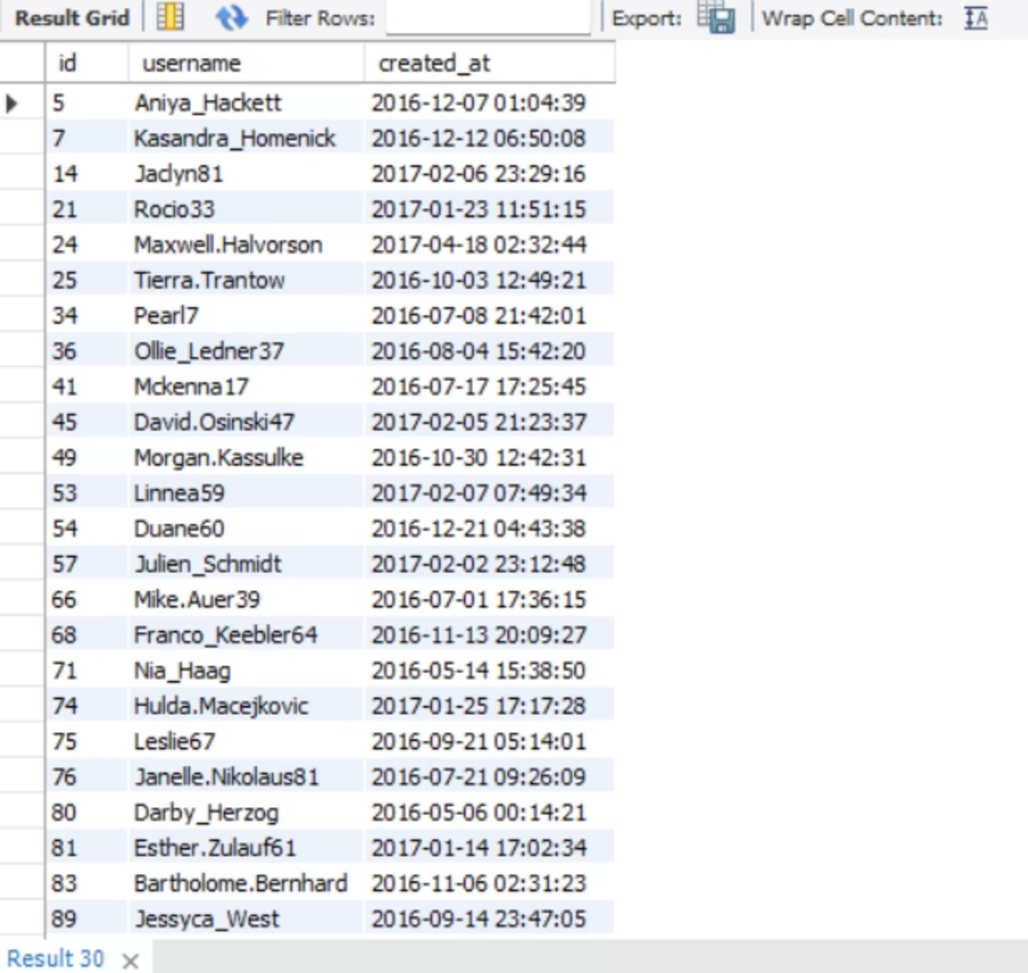
Query 2: Inactive Users
Goal: Identify users with zero posts.
Output:
This segment represents a significant opportunity for activation.
Understanding their behavior allows us to optimize on-boarding flows, address initial friction points, and convert registered users into active contributors, thereby increasing overall platform engagement.

Slide 7
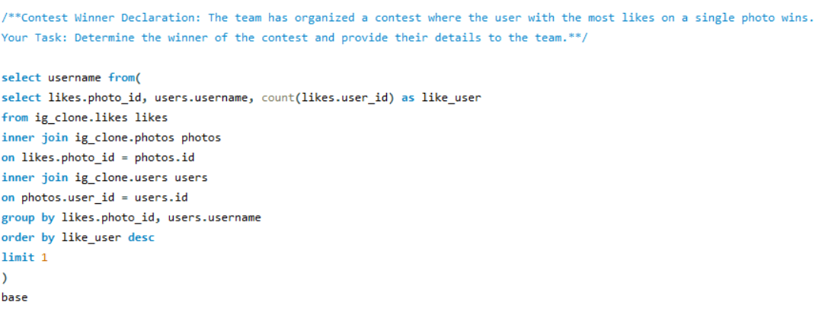
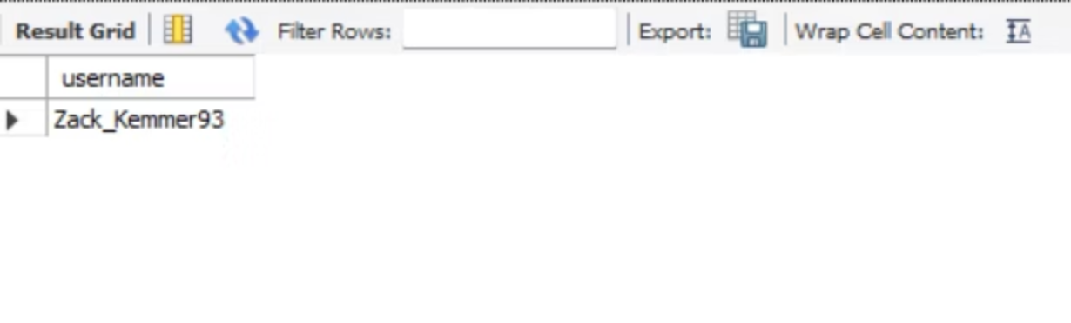
Query 3: Contest Winner
Goal: Find the user with most likes on a single photo.
Output:
This metric not only determines a winner but also highlights content that resonates most with the audience.
Such insights are invaluable for content creators and marketing teams looking to replicate success and understand viral potential within the platform.

Slide 8
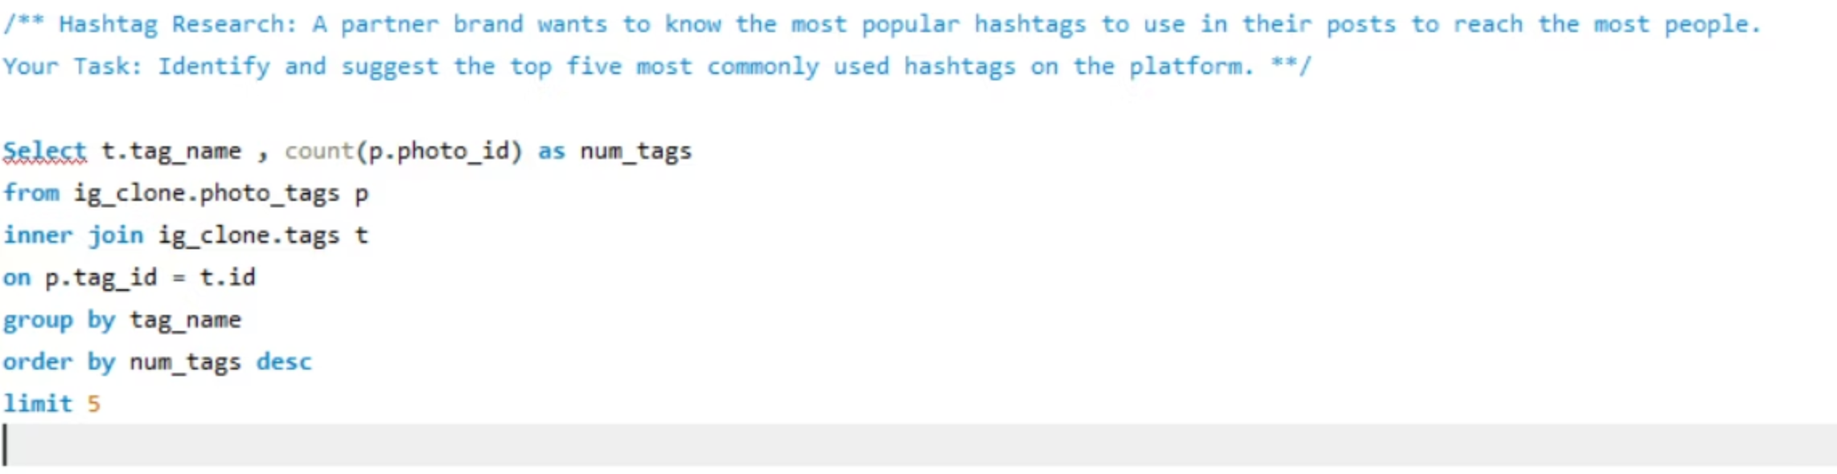
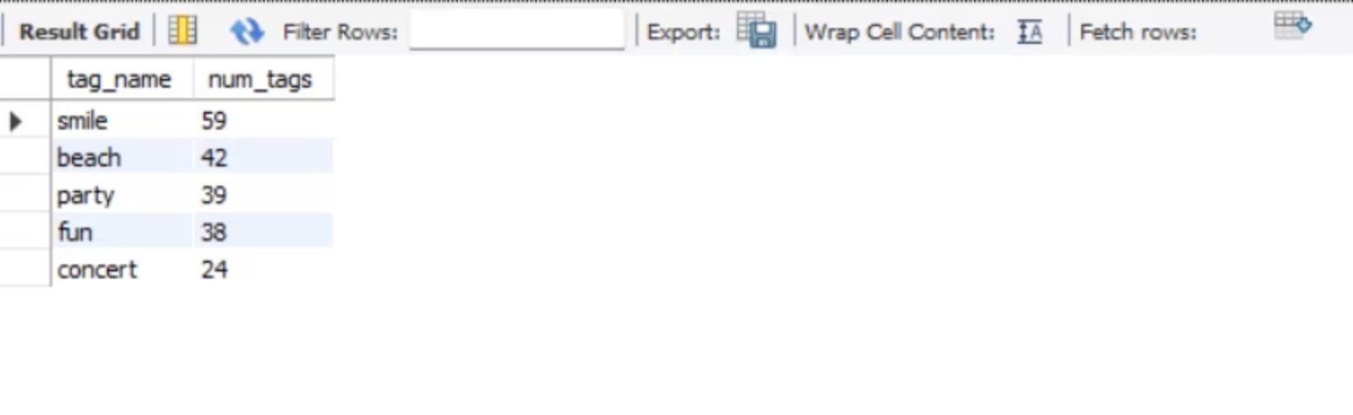
Query 4: Popular Hashtags
Goal: Identify top 5 most used hashtags.
Output:
This analysis directly informs content strategy, enabling creators to optimize their posts for maximum reach and engagement.
It also highlights emerging cultural shifts or product interests, offering a pulse on the user community.

Slide 9
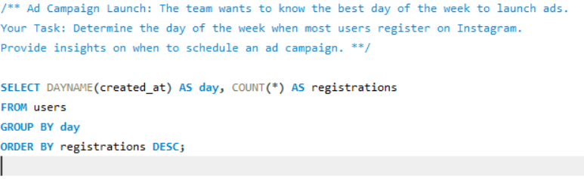
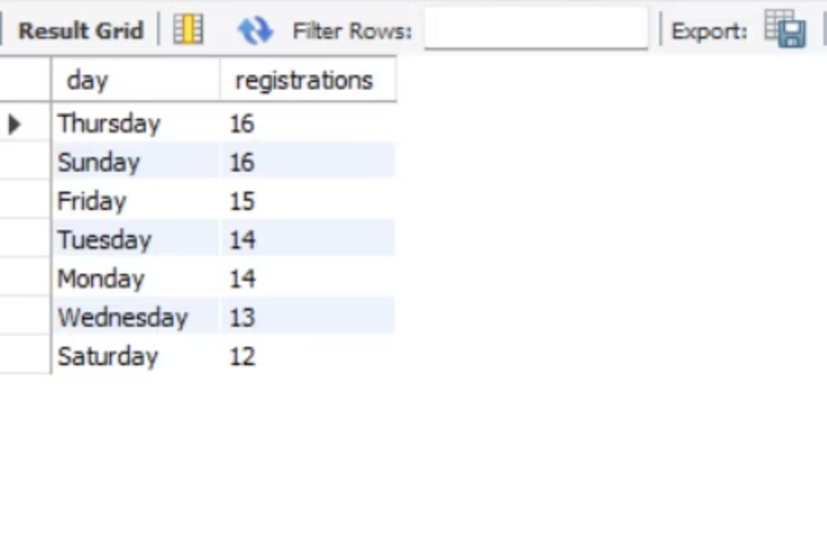
Query 5: Best Ad Campaign Day
Goal: Find the day with most user registrations.
Output:
This precise timing allows marketing teams to schedule their campaigns when the target audience is most receptive, potentially leading to lower Cost Per Acquisition (CPA) and higher conversion rates.
Our analysis revealed Thursday and Sunday as optimal days for acquisition.

Slide 10
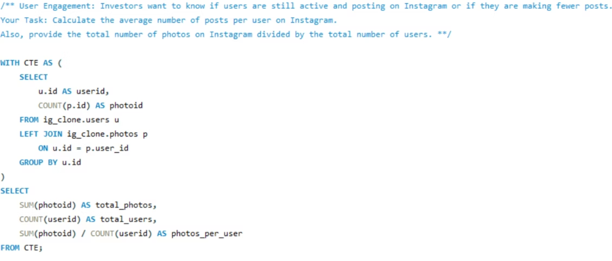
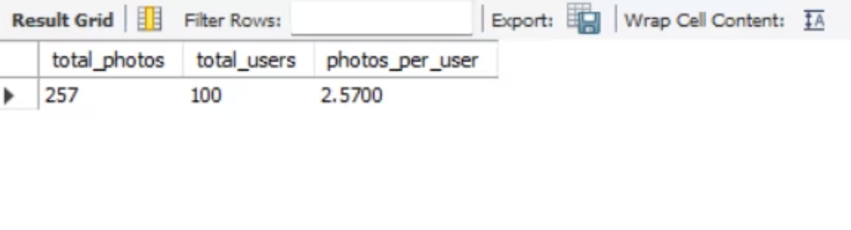
Query 6: User Engagement (Investor Metric)
Goal: Calculate total photos, total users, and average posts per user.
Output:
With an average of 3 posts per user, this metric offers a baseline for platform activity.
It helps investors gauge content generation vitality and identify growth or stagnation patterns over time.

Slide 11
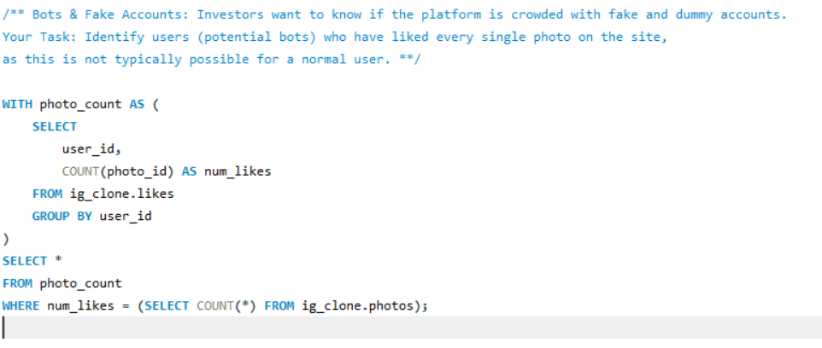
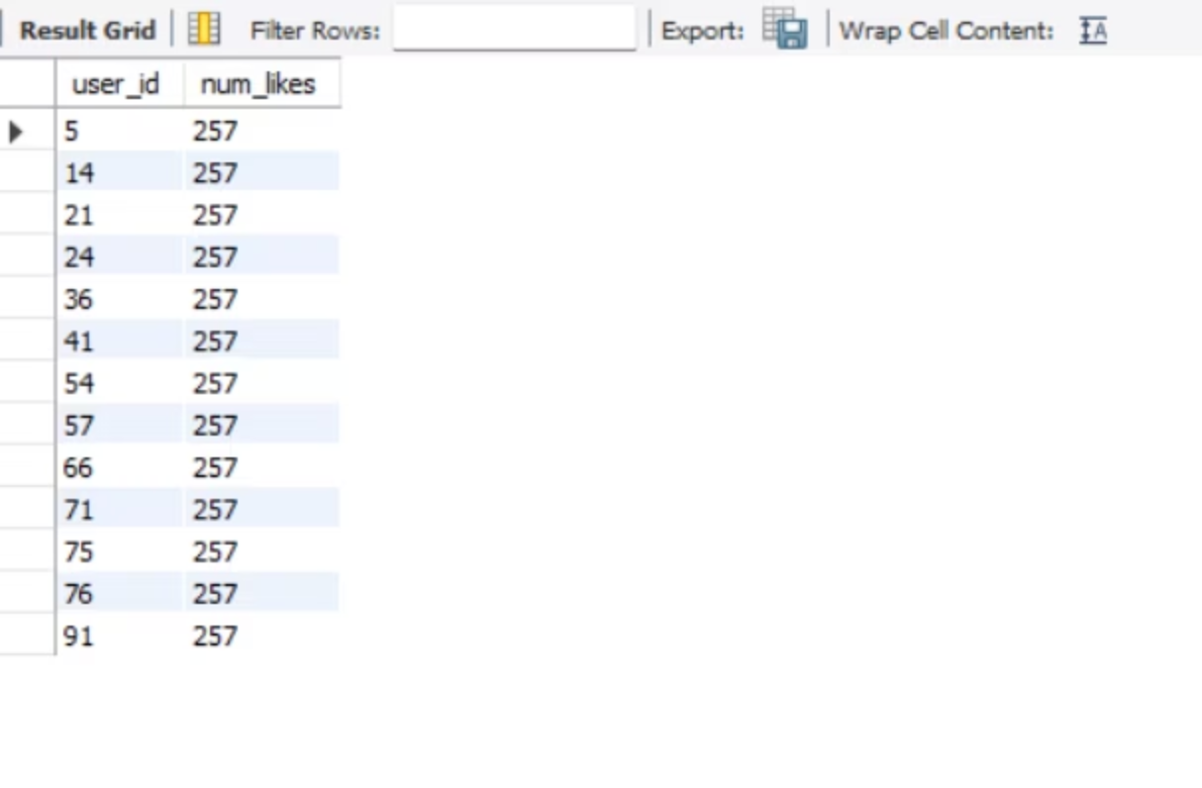
Query 7: Bots & Fake Accounts
Goal: Find users who liked every photo.
Output:
This query is critical for maintaining platform integrity.
Accounts liking every photo are highly suspicious of bot activity, impacting genuine engagement metrics and potentially diluting ad effectiveness. Identifying these helps ensure a healthy user ecosystem.

Slide 12
Insights
Loyal users identified for reward programs.
Inactive users targeted for re-engagement.
Top hashtags found for content optimization.
Thusday and Sunday identified as best day for campaigns.
Detected suspicious accounts liking all photos.
Average post rate per user = 3 posts.

Slide 13
Suggestion & Recommendations
1.Loyal User Reward Program
2. Inactive User Re-engagement Strategy
Insight from your project: You identified the 5 oldest users on the platform.
Suggestion:
Introduce exclusive loyalty badges, early feature access, or creator boosts for these users.
Rewarding early adopters improves retention and community trust.
Why it matters (Business):
Loyal users often act as brand ambassadors
Higher retention = lower customer acquisition cost
Insight: You identified users with zero posts.
Suggestions:
Send personalized onboarding emails
Offer first-post incentives (stickers, story boosts)
Show guided “how to post” tutorials in the app
Why it matters:
Activating inactive users is cheaper than acquiring new users
Improves platform engagement metrics

Slide 14
3.Contest Winner & Viral Content Strategy
4.Hashtag Optimization Strategy
Insight: You found the user whose photo received the maximum likes.
Suggestions:
Analyze content patterns (hashtags, captions, posting time) of high-engagement posts
Replicate winning content formats in marketing campaigns
Feature such creators on the Explore page
Business Value:
Helps understand what content goes viral
Improves creator satisfaction and content quality
Insight: Top 5 most-used hashtags identified.
Suggestions:
Recommend top hashtags to creators while posting
Create trending hashtag dashboards
Detect emerging hashtags weekly
Why it matters:
Better hashtag usage → higher reach → higher engagement
Supports creators and advertisers

Slide 15
5.Ad Campaign Timing Optimization
6.Investor Engagement Metrics Enhancement
Insight: Thursday and Sunday have the highest registrations.
Suggestions:
Schedule paid ad campaigns and influencer posts on these days
Launch promotions just before peak registration days
Business Impact:
Lower Cost Per Acquisition (CPA)
Higher conversion rate
Insight: Average posts per user ≈ 3 posts.
Suggestions:
Track monthly active users (MAU)
Add growth trend analysis (users over time)
Monitor drop in posting frequency
Why Investors Care:
Indicates platform health
Predicts long-term growth

Slide 16
7.Bot & Fake Account Detection
Insight: Users who liked every photo were identified.
Suggestions:
Flag these accounts for manual or automated review
Introduce rate limits on likes
Use behavioral thresholds (likes per hour/day)
Business Benefit:
Protects ad performance
Maintains platform authenticity

Slide 17



Results
7 actionable insights
Improved strategies
Strengthened skills
delivered to marketing & investor teams.
ad targeting, hashtag usage, and user engagement.
SQL data analysis.
Drive link: https://drive.google.com/drive/folders/1DJnWnYCm9pfpLsP4E9n0VqAJP5CGFpmq?usp=drive_link

